Slide 1

SDLC Agile Presentation
Nicholle Caudy
CS250 SDLC
This Photo by Unknown author is licensed under CC BY-NC.

Slide 2

Product Owner
Prioritizes work by creating and managing a Product Backlog
Ensures this Product Backlog is visible, transparent, and current
Maintains contact with the client and stakeholders and communicates any changes as needed
Optimizes the work being performed by the team
Creates User Stories for Sprints
This Photo by Unknown author is licensed under CC BY.

Slide 3
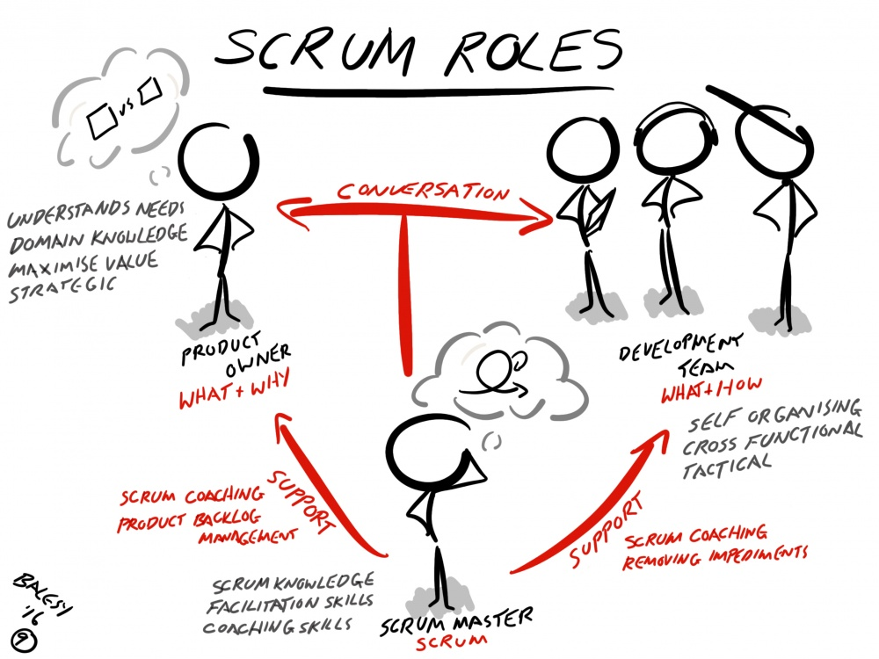
Scrum Master
The Scrum Master is a servant-leader
Holds Daily Stand-up meetings for the team to have open, honest communication
Helps remove any impediments that maybe be hindering progress
Acts as a coach to the team for self-organization and cross-functionality
Facilitates other Scrum events as needed and required
Helps the Product Owner with the Product Backlog
Coaches the organization in the Scrum adoption
This Photo by Unknown author is licensed under CC BY-SA.

Slide 4


Developer
Self-organized, cross-functional team members that decide how and when parts of the project will be completed
Must be able to have clear communication with everyone on the team as well as the clients and stakeholders
Uses the user stories and Product Backlog to create a functional product for the client
May also act as a tester to ensure the code is well developed with little to no issues

Slide 5

Tester
This Photo by Unknown author is licensed under CC BY-NC-ND.
Needs to have a clear understanding of the final product
Works closely with the Product Owner and Development Team to gain the understanding of the final product
Runs test cases on and algorithms on the deliverables
Must maintain clear and effective communication with all team members
Advocate for quality and user satisfaction

Slide 6
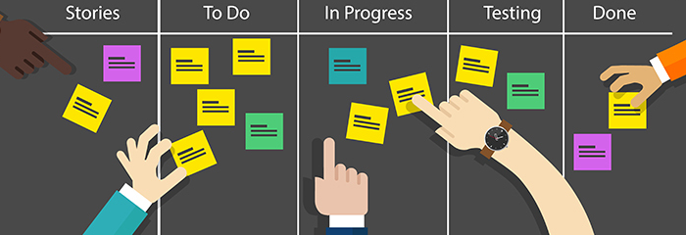
Phases of the Agile Approach
Planning and Analysis: This phase is gathering requirements from the client and stakeholders, and evaluating the potential product, revenue, cost, and the needs of the users.
Define Requirements: This phase is converting the information obtained from the previous phase into clear requirements for the team. This can be done with User Stories, a Product Backlog, and Scrum Meetings.
Design: In this phase, the team members divide the project into Sprints (using User Stories and Product Backlog) and turn the requirements into code that will make the product. Having Daily Stand-up Meetings to discuss what has been completed, what needs to be completed, and any impediments along the way.
Testing: Performance testing, functional testing, unit testing, usability testing, and acceptance testing are all part of this phase and are done before the product is released to the production environment.
Deployment: In this phase, the final product is released to the end users. At this point, a Sprint Retrospective would be appropriate to discuss the project and talk about what went right and what didn't go so right.
Maintenance: This final phase of SDLC, for agile is only a stage for further improvement and is used if users find a bug that was missed, or an error was made.
This Photo by Unknown author is licensed under CC BY-SA.

Slide 7
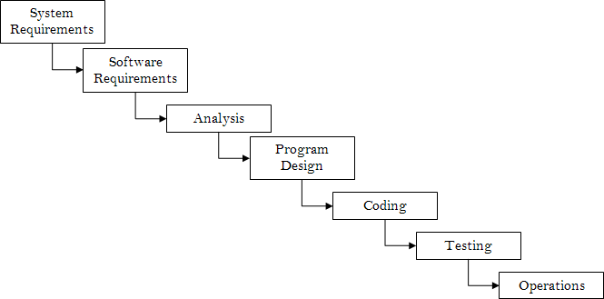
Waterfall Approach
During the SNHU Travel project, the direction was changed halfway through the project. Using the Waterfall methodology approach would have made the changes needed far more difficult.
Because Waterfall is a sequential process the rework to change direction would have been very cumbersome.
The Testers would have received the project last and would have had to recreate their algorithm and testing parameter at the end instead of being able to implement them earlier on in the project and work with the developers before there were any issues.
This Photo by Unknown author is licensed under CC BY-SA.

Slide 8

Agile or Waterfall
Waterfall Methodology
Agile Methodology
Requirements for projects are well-defined.
Stockholders and clients wait until the end to see product. The client would have had to wait until after the delivery of the product to ask for changes to be made, or it would have created large delays
Work is done sequentially. This would have caused a large amount of rework to execute the changes that needed to be made halfway through the project.
More suited for manufacturing
Requirements for projects are vague
Stockholders and clients see progress throughout the project and can provide feedback throughout. This allowed us to make the changes for the users to see detox/wellness quickly and effectively
Work is done concurrently. Allowing us to make the changes needed without having to rewrite code from the beginning.
More suited for software development. Which fits perfectly for our client, SNHU Travel.

Slide 9
References
Cobb, C. G. (2015). The Project Manager's Guide to Mastering Agile: Principles and Practices for an Adaptive Approach. Hoboken: Wiley.
Clark, H. (n.d.). The Software Development Life Cycle (SDLC): 7 Phases and 5 Models. The Product Manager. Retrieved August 7, 2023, from https://theproductmanager.com/topics/software-development-life-cycle/

